Slide 1
Mid Circuit Measure & Reset
ECE-592 Quantum Computing
Ashwin Karthik (ashanka7)
Pradeep Vetapalem (vkrish7)

Slide 2
Introduction
Reuse qubits in same circuit
Reuse qubits and merge jobs
Error Correction

Slide 3
Why Measure and Reset?
Reuse:
More wait times with jobs involving more qubits.
Limited number of qubits on the HW.
Less execution time when jobs are merged.
Error Correction.

Slide 4
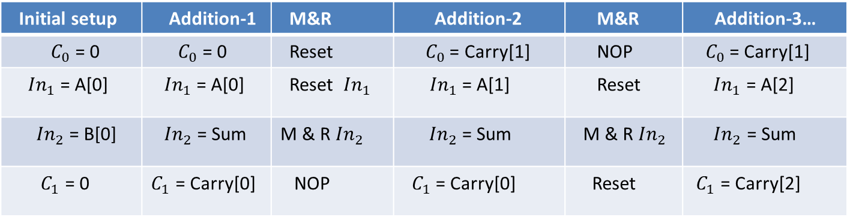
Application-1:
Reuse qubits in the circuit:
Circuit implemented: n-bit full adder
Number of qubits used: 4(fixed) IN1, IN2, C0, C1
Initial setup | Addition-1 | M&R | Addition-2 | M&R | Addition-3…
$C_{0}$ = 0 | $C_{0}$ = 0 | Reset | $C_{0}$ = Carry[1] | NOP | $C_{0}$ = Carry[1]
${ In}_{1}$ = A[0] | ${ In}_{1}$ = A[0] | Reset ${ In}_{1}$ | ${In}_{1}$ = A[1] | Reset | ${ In}_{1}$ = A[2]
${In}_{2}$ = B[0] | ${ In}_{2}$ = Sum | M & R${ In}_{2}$ | ${ In}_{2}$ = Sum | M & R${ In}_{2}$ | ${ In}_{2}$ = Sum
${ C}_{1}$ = 0 | $C_{1}$ = Carry[0] | NOP | ${ C}_{1}$ = Carry[0] | Reset | ${ C}_{1}$ = Carry[2]

Slide 5
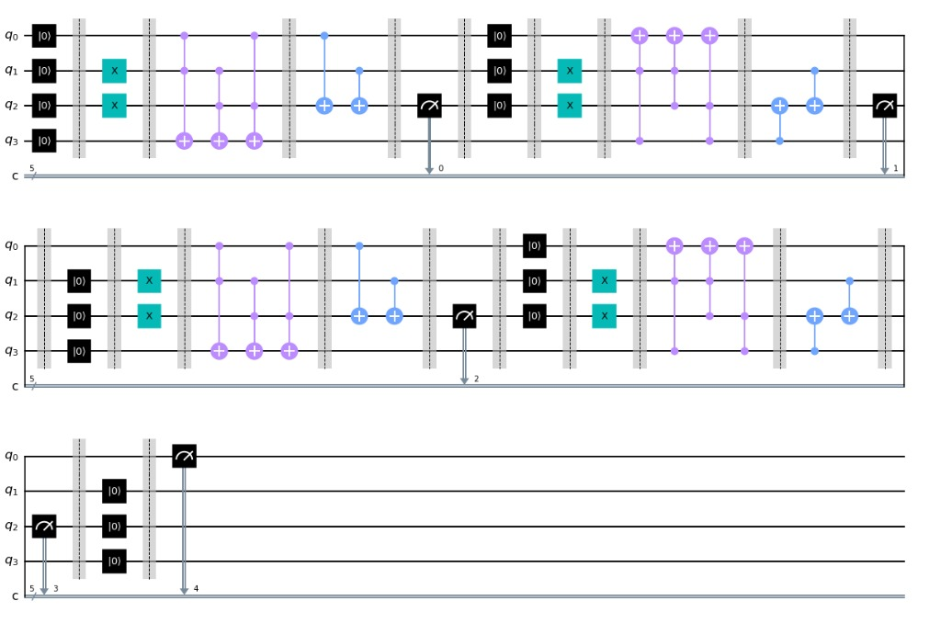
Application-1: ADD(4’b1111,4’b1111)

Slide 6
Application-1:
We reused all the qubits instead of just ancilla bits. On instantiated multiple qubits for each input, we saw improvement in probabilities, but didn’t observe fidelity increase trend over
Increase in resets count.

Slide 7
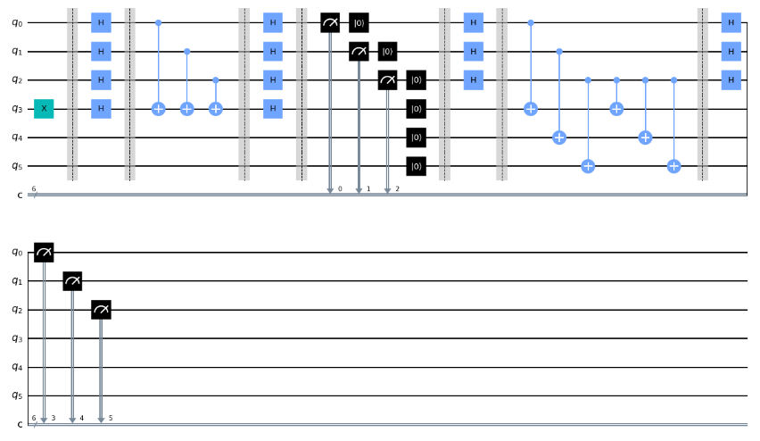
APPLICATION 2: FUSING SIMON AND BERNSTEIN VERZERANI CIRCUIT USING MID CIRCUIT MEASUREMENT AND RESET
A 2 BIT BERNSTEIN VERZERANI CIRCUIT FUSED WITH 2 BIT SIMON CIRCUIT

Slide 8
Application-2:
Fusing multiple Jobs
EXECUTION TIME ANALYSIS
The Comparison was made between time taken when circuits run as separate jobs vs run as combined job.
Combining the jobs resulted in significant reduction of total runtime.
The scheme was tested for string lengths
ranging from 1 to 5. The run-time improved
by two folds on an average.

Slide 9
Application-2:
Fusing multiple Jobs
FIDELITY ANALYSIS
Combining the jobs had better runtime but comes with a trade off.
The fidelity decreases rapidly as the string length increased exhibiting sub-optimal performance than running Simon separately.
Noise caused by resetting and reusing the qubits

Slide 10
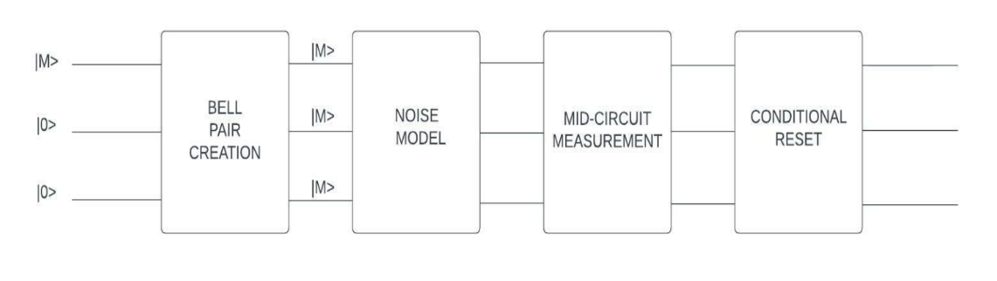
Application-3:
Error Correction:

Slide 11
Application-3:
M : 0/1
N: Correction bits used
Noise Model: ibmq_mumbai
Correction logic:
1. Simulate the circuit and collect top ‘N’ values.
2. If 1’s >= 0’s , inc. ones_count. Else inc. zeros_count.
3. Run the same for 1->N.
Correction rate: 100% (1-8 correction bits)
Manual tweaking of NoiseModel gave mismatches post correction.

Slide 12
Future plans:
Improve the full adder circuit to achieve better probability over reset counts.
Improve the BV+Simon fusion circuit to see better fidelity.
Implement more sophisticated Error Correction circuit where a single correction bit can detect and fix errors in multiple qubits.

Slide 13
Thank you!
Q&A:

